Slide 1
RESILIENCE AGAINST NATURAL DISASTERS: PIURA RIVER’S EARLY WARNING SYSTEM
 | World Federation of Engineering Organizations Committee on Disaster Risk Management
TECHNICAL PROPOSAL
PERUVIAN ASSOCIATION OF PROFESSIONAL ENGINEERS
Lima, 2018

Slide 2
Sustainable Development Goals (SDGs)

Slide 3
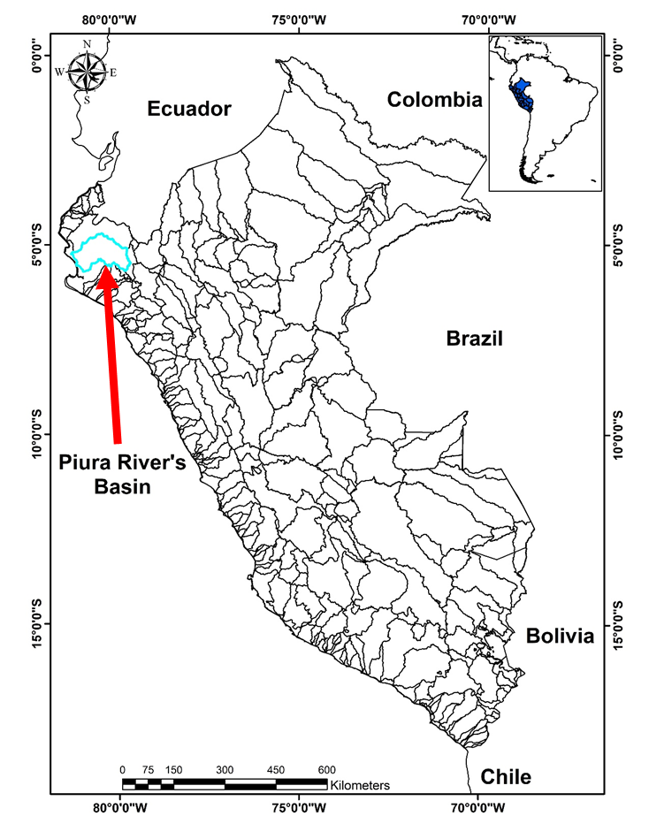
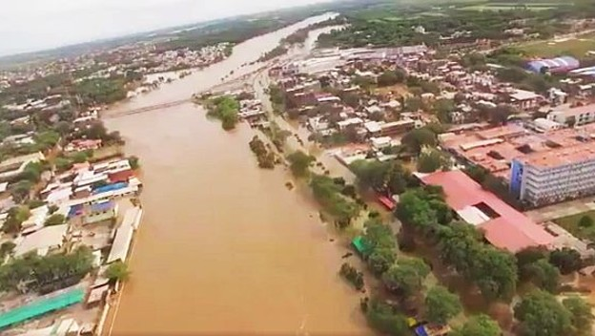
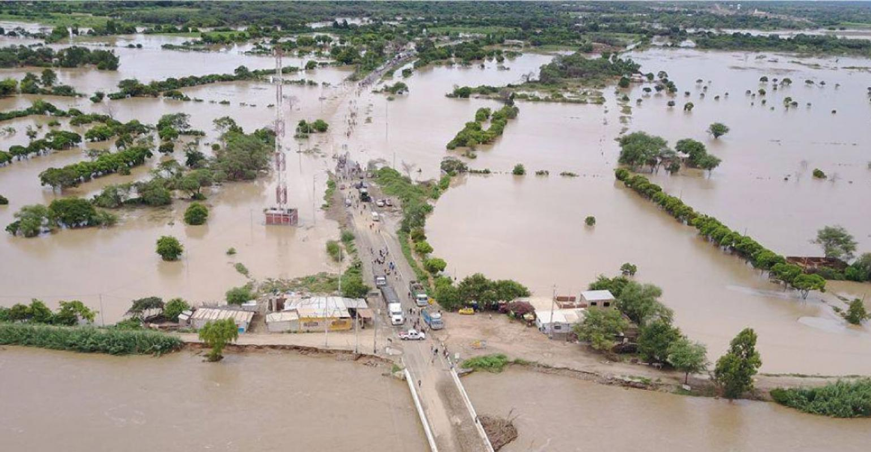
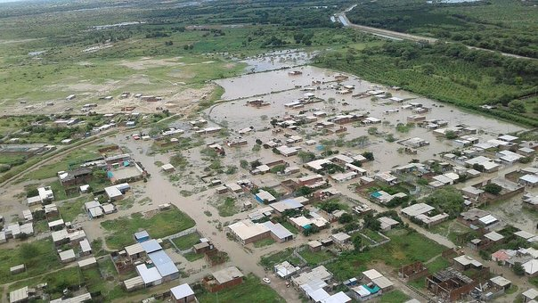
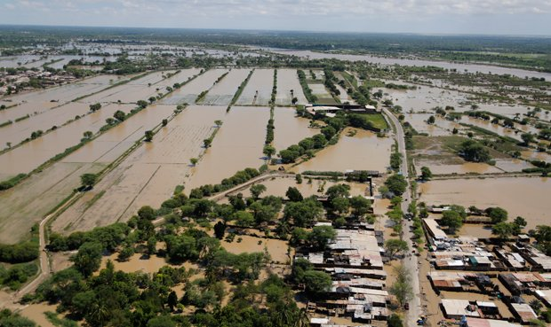
PROJECT LOCATION

Slide 4
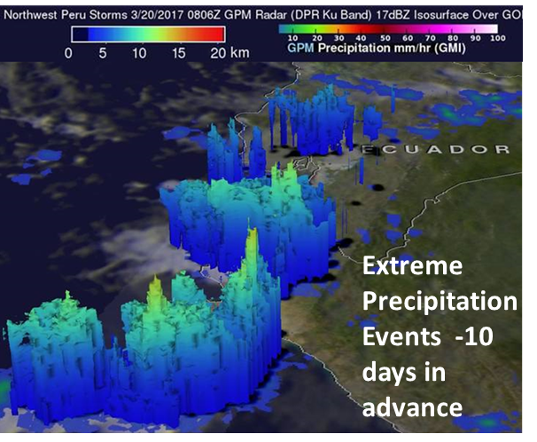
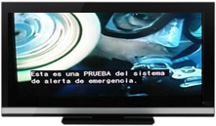
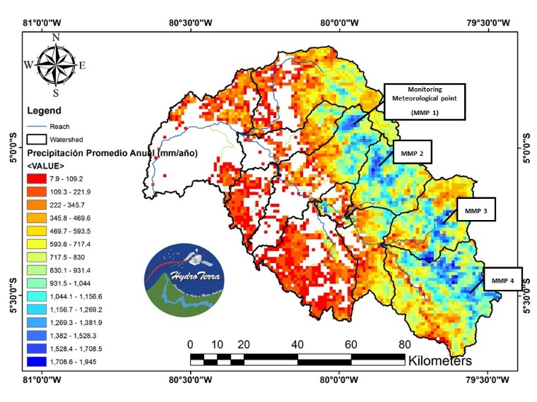
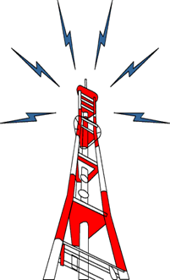
PIURA RIVER’S EARLY WARNING SYSTEM
Historical Hydrology Calibration
Satellite Info 1998 - 2017

Slide 5
PIURA RIVER’S EARLY WARNING SYSTEM
Structure of the Early Warning System:

Slide 6
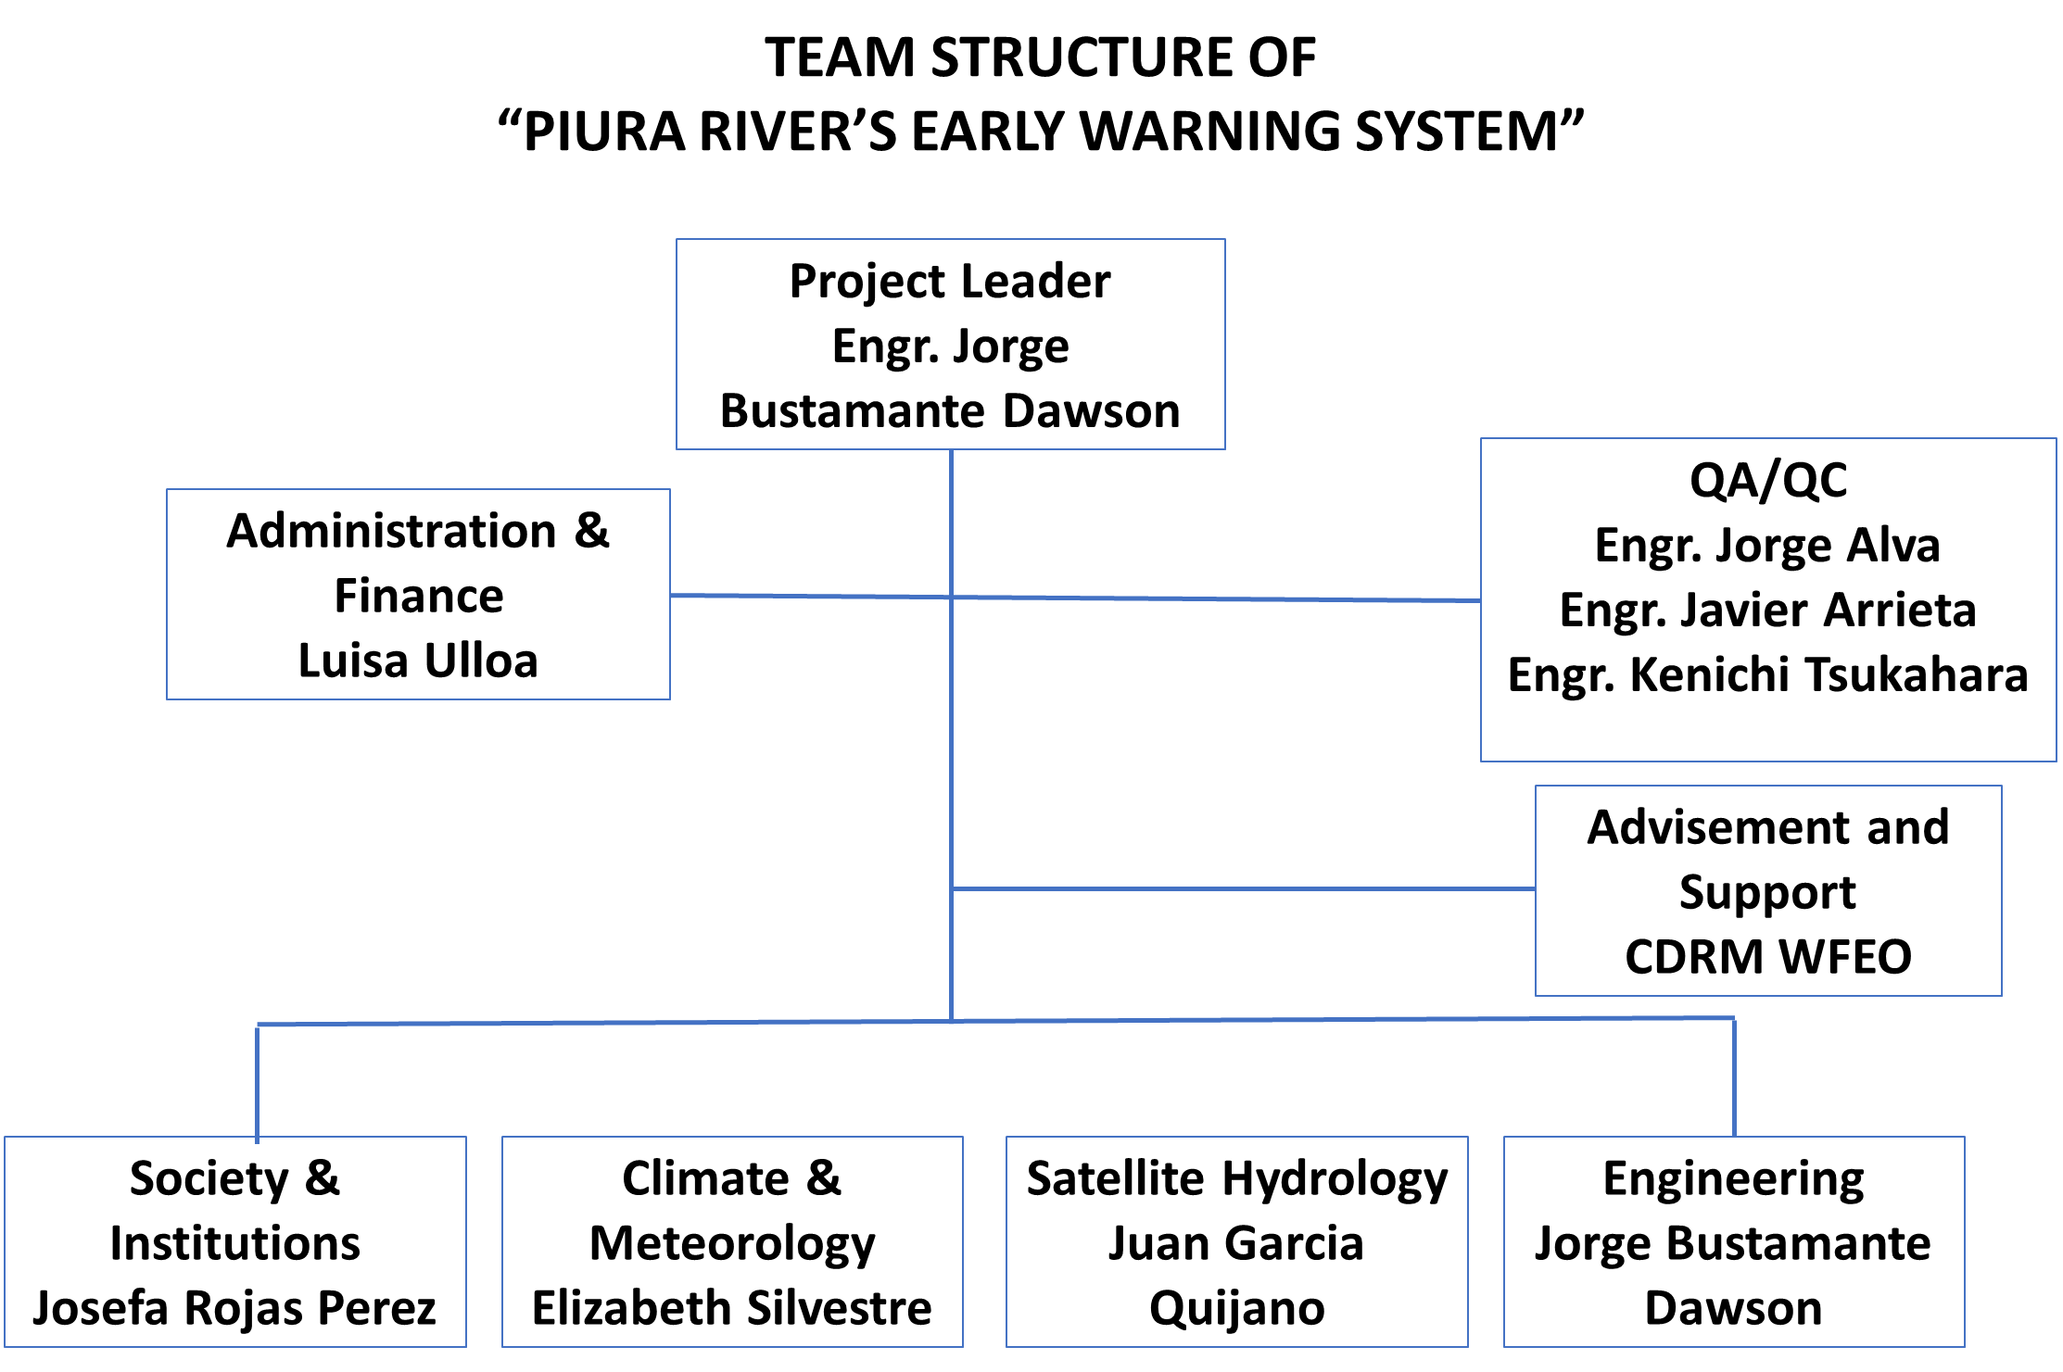
PIURA RIVER’S EARLY WARNING SYSTEM

Slide 7
PIURA RIVER’S EARLY WARNING SYSTEM
International Experience

